Slide 1
Moment Of Inertia

Slide 2
Motivation
To achieve scale, translation and rotation invariance in object recognition, we need to identify intrinsic traits of the object that are not affected by these operations.

Slide 3
Moment Of Inertia
Moment of Inertia is mass property of a rigid body that determines the torque needed for a desired angular acceleration about an axis of rotation. Moment of inertia depends on the shape of the body and thus can be used as parameter for simple object recognition.

Slide 4

Calculation of MOI
Moment of Inertia can be calculated if given centroid of the object and its mass.
I: Moment of Inertia
m: unit mass at a location of distance r from the centroid
r: distance from the centroid

Slide 5
Application to Object Recognition
A two-dimensional image does not have the mass to be used for calculation of MOI. However, we can use the intensity of each pixel as mass of a particle located at the pixel. With that, we can calculate the MOI of our images.

Slide 6
Application to Object Recognition
Since we are only concerned with the shape of the object, we can convert the images to black and white (with intensity of each pixel being either 0 or 1) and consequently the intensity of each pixel can only take on 2 values and the MOI can be much more easily calculated given this simple duality.

Slide 7

Formula used for Project
x: x-coordinate of pixel with value 1
y: y-coordinate of pixel with value 1
Cx: x-coordinate of Centroid
Cy: y-coordinate of Centroid

Slide 8
Read Image
Black&White Image
Centroids of Objects
Boundaries Indices
Mask image to show 1 object at a time
Moment of Inertia of Objects

Slide 9
Main Functions used
im2bw: Change image to B&W
bwboundaries: Getting boundary indices of objects
Regionprops:Getting Centroids

Slide 10
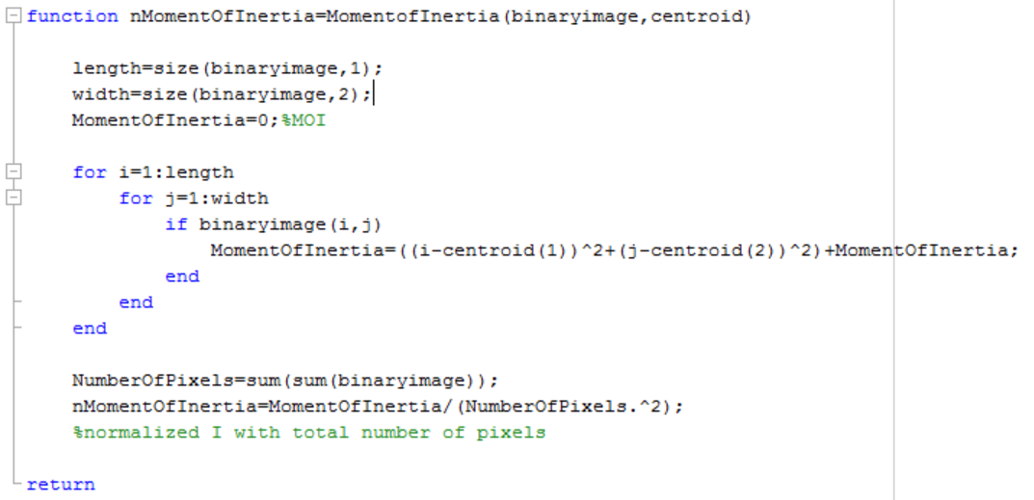

Slide 11
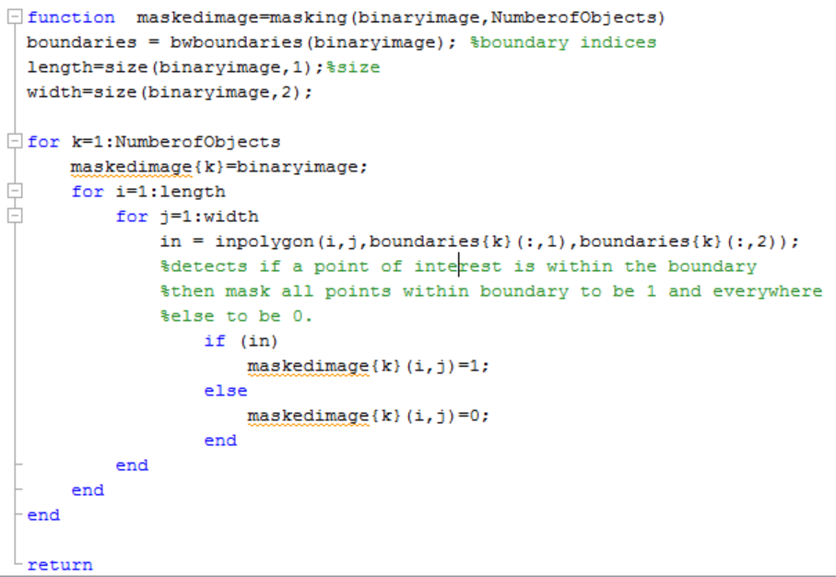

Slide 12
Limitations
Moment of Inertia is a rather rudimentary approach to object recognition because of its apparent limitation for detecting objects with similar MOI’s. In real life application, MOI can be used as a pre-processing tool to reduce computation complexity for more advanced object recognition algorithms.

